Slide 1
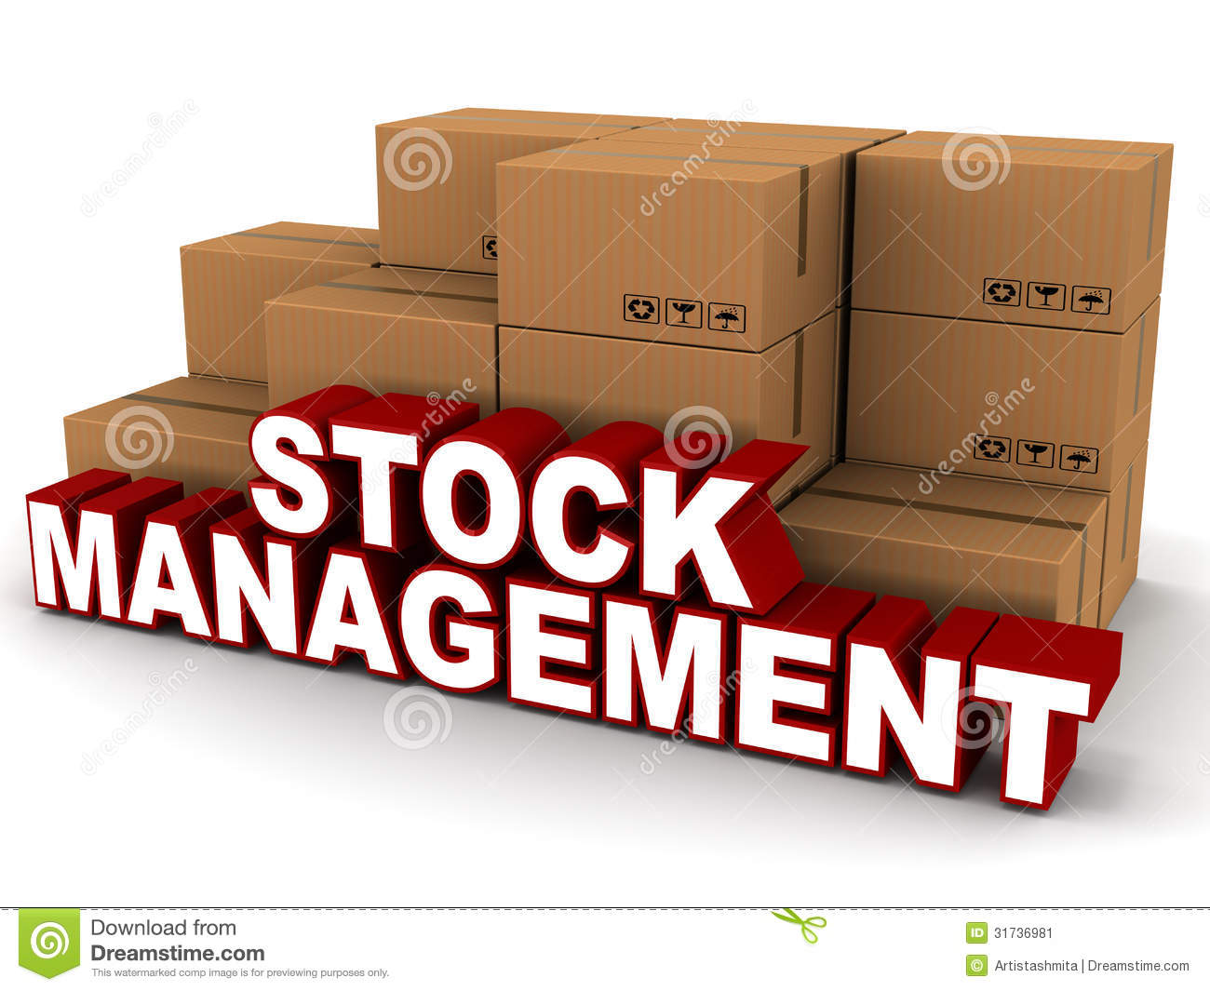
Stock Management System Mandira Tamang

Slide 2
Stock Management System
Stock Management System is the software which is widely used to manage the product available in the warehouse or can manage in the shop as well.
It helps in the management of stock exchange and give the exact database management required.
This software involves the billing system as well of products.

Slide 3
Aims of Stock Management System
Followings are the aims of sms
The main aim is to manage the product available in the stock in the systematic way.
To keep the records of products and manage it properly in the database.
To display the available products and their details.

Slide 4
Objectives of stock management system
To meet the given aims here are the objectives of sms
Firstly collecting the requirements
Designing the database for sms
Performing the installation
Performing the planning
Performing the testing
Performing the release

Slide 5
Methodology used
There are different methodology which helps to complete the project in the systematic way and helps to develop the project that we need. Like waterfall, agile, etc.
Among the different methodology I have chosen the waterfall method to develop this project.
Waterfall method
It is the one of the best method that is used to develop the projects. Especially this method is used to develop the big projects like projects of governments, etc.
Waterfall method follows the rules and regulations.
It performs the work in the step wise which are analysis, design, implementation, testing and deployment.
These steps play the vital role to develop the project.
With the help of this method the work flow is like the waterfall where without completion of one stage it cannot go further in the other stages.

Slide 6
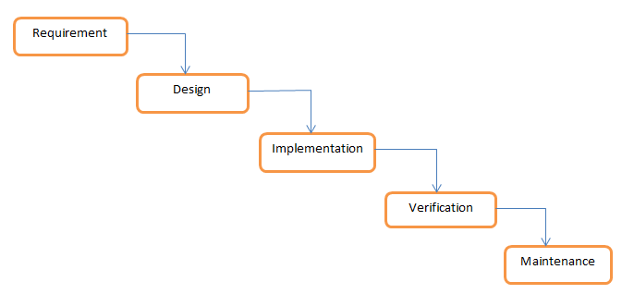
Diagram of waterfall method

Slide 7
System Architecture
System architecture
It is the conceptual model which defines the structure, behavior, and more views of a system. It is the representation of the system organized in a way that supports reasoning about the structures and behaviors of the system.
For the development of this project I used the Three Tier Architecture. It is the web based application which is divided into 3 layers
1.Presentation layer
It is the first layer which is handle by the client system.
It transfer the data to the application layer
2. Application layer
It is the middle layer which is handle by the application server.
It helps to transfer the data between the presentation and database layer.
3.Database layer
It the third layer which is handle by the server system.
It helps to store and retrieve the information from database or file system.

Slide 8
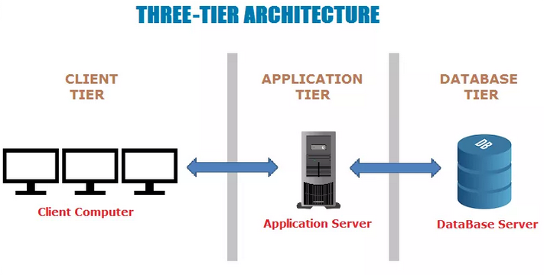
Diagram of three-tier architecture

Slide 9
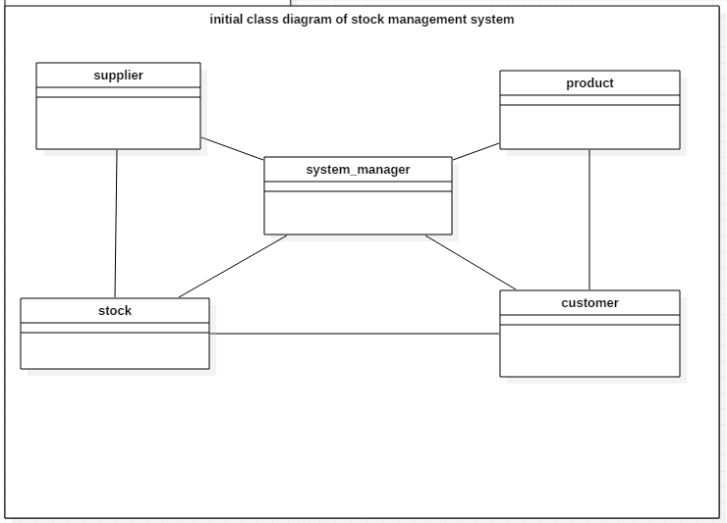
The class diagram of Stock Management System
Class diagram is graphical representation which involves different classes and relationship between them.
Class is made up of attributes and operations.
It helps to give the clear sketch of the system required.
It gives the information of system structure or design.
It is flexible.

Slide 10
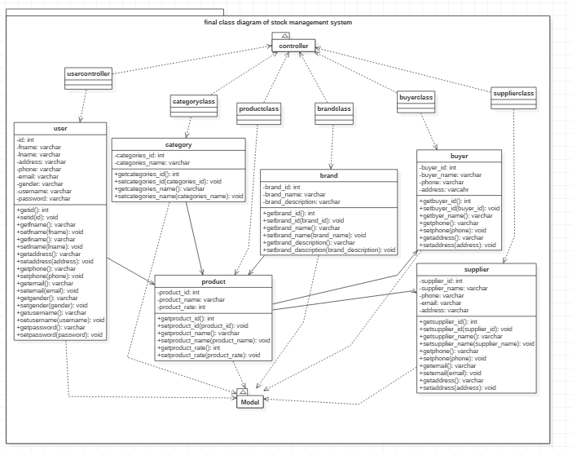
Final class diagram

Slide 11
Class diagram
The class diagram for stock management is given above. The classes of
Stock management system are user, product, category, brand, supplier and buyer. So the buyer can buy the product that are available and supplier will supply the product to the buyer.
The class diagram for stock management system is made in the MVC design pattern as given in the figure.
The attributes and operation of classes also given clearly.

Slide 12
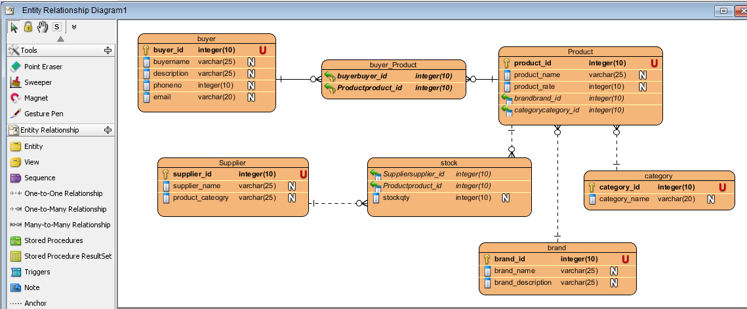
Er-diagram of stock management
Er-diagram is the visual representation which is like the class diagram but it involves the entities .
It shows the relationship between the entities.
It decreases the complication and provide the simple way to understand the system..
It is flexible as we can make other relationship from the existing ones..

Slide 13
Activity diagram of stock managent system
Activity diagram is one of the most important diagram which shows the dynamic view of the system.
It shows the flow from one activity to another activity.
It shows the real work flows of the system.
It easily helps to understand the work flow of the system.
It is user-friendly as shows the actual work of the system.

Slide 14
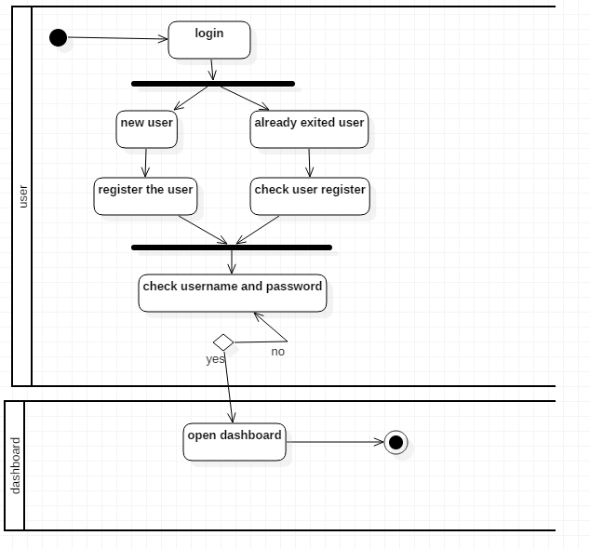
Activity diagram of login system of stock management system

Slide 15
Activity diagram of login
Firstly the user login in the system.
If its new user, then they can register and login.
If already exect, then they can enter their email and password and login.
After login, the dashboard will appear in the screen.

Slide 16
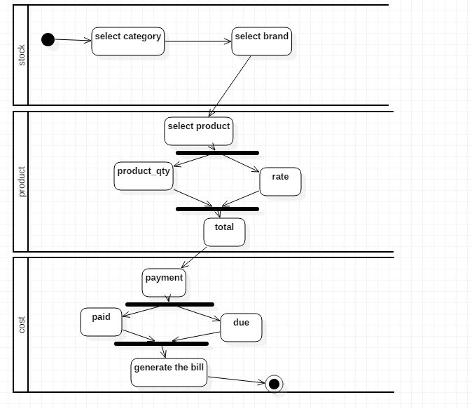
Activity diagram of stock

Slide 17
Activity diagram of stock
The admin can add the category, brand and product.
They can add stock as well.
They can calculate the payment of the product.
They can print out the bill payment of the product.

Slide 18
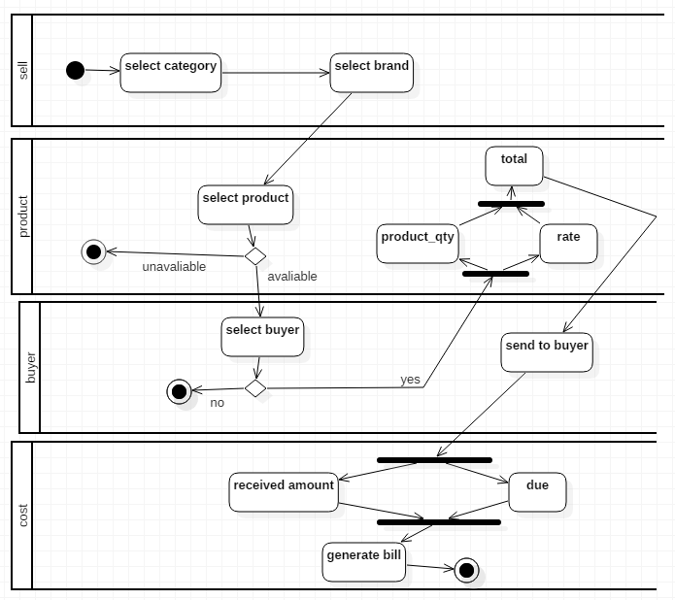
Activity diagram of selling the product to the buyer

Slide 19
Activity diagram of selling the product
To supply the product to the buyer, firstly select category and brand.
After selection, check if the product is available or not.
If product is available then select the buyer who needed it.
Then make the payment of product.
Lastly generate the bill.

Slide 20
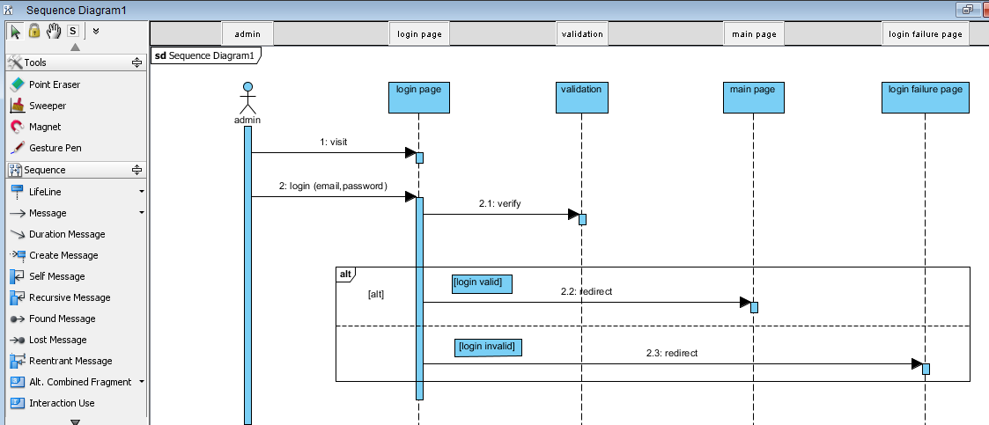
Sequence diagram

Slide 21
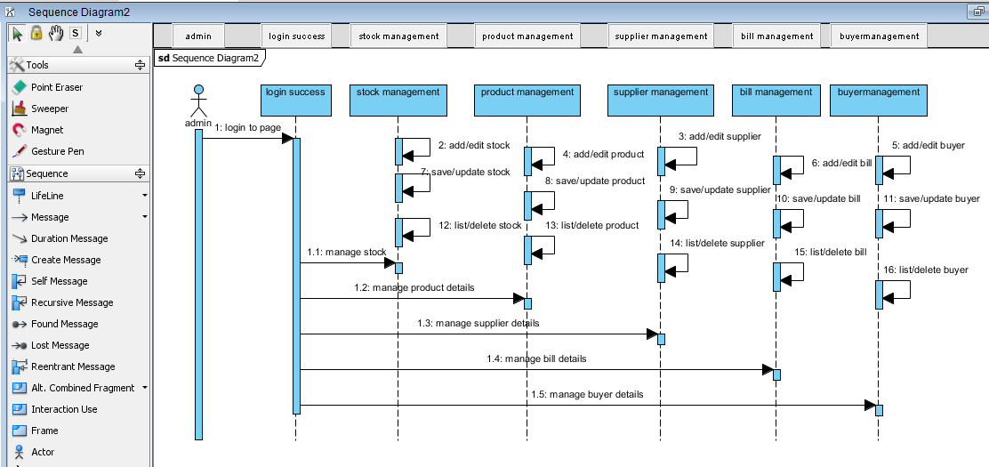

Slide 22
references
https://en.wikipedia.org

